Slide 1

Movie Review Sentiment Analysis Using Natural Language Processing
Johnny Dryman

Slide 2
Goals
Use Natural Language Processing (NLP) with machine learning models to classify IMDB user reviews as ‘Positive’ or ‘Negative’
Best model – Logistic Regression with Term Frequency – Inverse Document Frequency (TF-IDF)
Understand how our model distinguishes between ‘Positive’ and ‘Negative’
Explore alternative scoring system for movies based on sentiment analysis

Slide 3
Data
Obtained 50,000 IMDB movie reviews
Reviews are labeled ‘positive’ or ‘negative,’ and are considered “highly polar” reviews
25,000 positive
25,000 negative
No associated movies or traditional 1-10 rankings were provided
Model targeted ‘positive’ or ‘negative’ sentiment

Slide 4
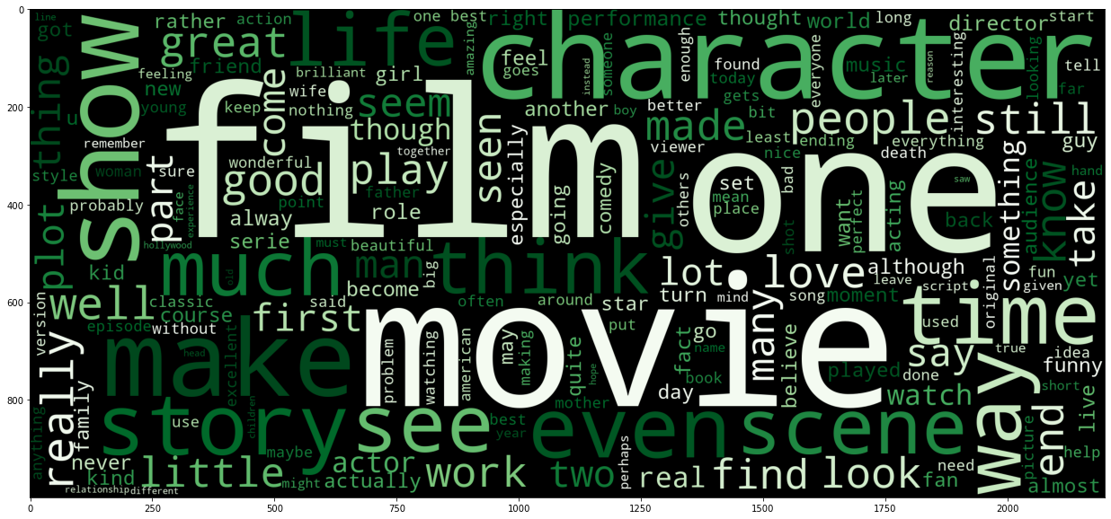
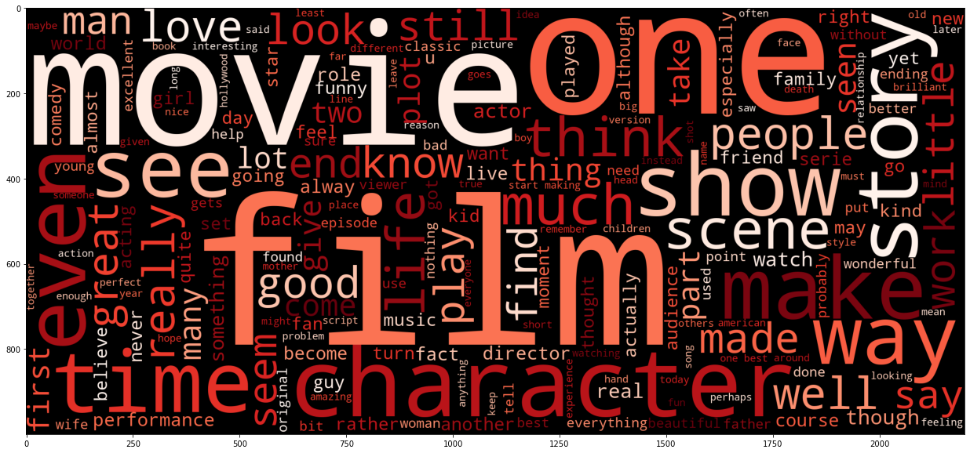
Word Clouds
Positive and Negative
Other than color palette, difficult to distinguish

Slide 5
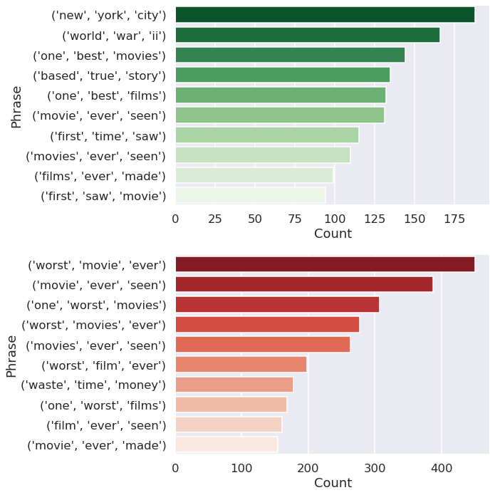
Trigrams
Positive and Negative
Collection of three words that appear most commonly
Generally superlative
“One best movies”
“Worst film ever”

Slide 6
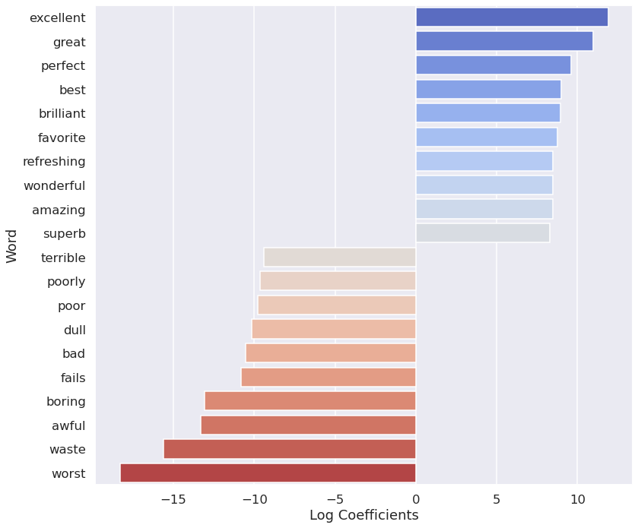
Best Model: Linear Regression
Model Accuracy: 89.51%
Coefficients:
Positive and Negative
Words that influenced towards or away from classifying a review as ‘positive’
Mostly strong positive or strong negative adjectives

Slide 7
Conclusions
Model depended on overtly positive or overtly negative adjectives
Review sentiment can be reasonably predicted with an accuracy of 89.5%

Slide 8
Recommendations
Use ‘positive’ and ‘negative’ sentiment model to calculate new score for all movies in database
Compile a new list of top 250 movies
Compare user scored top 250 with top 250 as calculated by sentiment analysis
Depending on results, release to public

Slide 9
Next Steps
Experiment with different tokenizers and stop word lists
Reviews were added to dataset based on “highly polar” nature, quantify or qualify what this means
Compile new dataset with buckets for multiclassification
Score of 1-3 / 10 = Negative
Score of 4-6 / 10 = Neutral
Score of 7-10 / 10 = Positive
Explore alternative machine learning models
Support vector machines
K nearest neighbors
Deep learning / neural network models

Slide 10
Thanks for your time!
Please feel free to ask any questions.

